Slide 1
Multifamily Forum San Francisco Bay Area Foster City November 1, 2017
TRAILBLAZING:
Innovative
Design &
Construction
Approaches
Notes:
We need a background image.

Slide 2
ZERO NET ENERGY
Easily achievable for 2 and 3 stories even in the Central Valley
High rise challenging
Lavender Courtyard study to determine means to ZNE in 4 story mixed-use
Notes:
Much of work in CV where temperatures increasingly reach 110°
Challenging with cooling loads
Utilities moving more to demand pricing
Achievable nonetheless with up to 3 stories easily with current energy code
PV prices continue to drop
The challenge is with increased height because of the lower ratio of roof area

Slide 3
ZERO NET ENERGY
STRATEGIES
Plug load management
Solar control
VRF cooling
Natural ventilation
Ceiling fans
Infiltration reduction (Aeroseal)
Really good glazing/ fiberglass windows
Enhanced insulation, including exterior rigid
Energy star tier 2 appliances
Solar hot water (50% assist)
Efficient HVAC
HRV Lifebreath 95 Max
CONSERVATION CRITICAL
Link to: Lavender Courtyard Energy Study
Notes:
Study to determine level of conservation strategies to get energy use low enough for proof top PV to achieve ZNE for a 4-story building on which we are working
Don’t review strategies
Regulators pushing to eliminate gas – challenge with available central hot water.

Slide 4
NATURAL VENTILATION COOLING
Driven by thermal buoyancy
Tercero 2 dormitory at UC Davis
Link to: Natural Ventilation Green Paper
mogaveroarchitects.com
Notes:
Dorm project at UCD
Corridors only
No conditioning of corridor – fanless air movement
Night purge and daytime cooling

Slide 5
VENTILATION COOLING
7th & H Apartments
Corridors – Fan powered / no mechanical cooling
Units – night purge with high velocity stacked bathroom ventilators
Notes:
Corridor pressurized
Units with variable speed both exhaust
Z ducts

Slide 6
WATER & ORGANIC RESOURCES
Study commissioned by California Energy Commission to determine energy, water and organic efficiencies of linking on site farm with multifamily housing
Link to: CEC Study
Notes:
This where I see the critical immediate future challenge in sustainability
Critical to California – water
Localized recycling of resources
CEC Study
resources (energy, water, organics)
efficiency from combining suburban redevelopment density MF with agriculture
first simple grey water

Slide 7
GREYWATER RECYCLING
First generation for Mather Veteran’s Housing
Uses greywater for irrigation
Notes:
On our third greywater recycling system
The first coupled with relatively conventional irrigation system
Clogging and other issues
High dual piping costs has thwarted this technology

Slide 8
CURRENT GREYWATER APPLICATION
Lindsay Apartments
Combines storm water purification, greywater recycling and landscape irrigation
Link to:
EPIC System
EPIC Construction Sequence
Notes:
Finally getting to apply a technology that caught our attention several years ago
Simple and seems to avoid all the other problems
Still have cost of dual piping for waste
Expensive

Slide 9
BLACK WATER RECYCLING
Evolving quickly
No double piping
Only slightly higher level of treatment needed relative to grey water
Link to: SF Utility Building
Notes:
This building treats and recycles its black water on site
With rapid advancement of technology and cultural norms black water recycling will supersede grey water

Slide 10
WATER TREATMENT & LOCAL FOOD GROWING
Sierra Vista Community Redevelopment
On site farm and black water recycling
Notes:
Opportunity to integrate the water recycling and agriculture
Complete multiphase redevelopment of a 42-acre housing authority property with mixed income at double existing density. MP calls for farm and black water recycling among other social and eco innovations such as live/work within units
Negotiating with farm and selecting consultant for black water

Slide 11
COMMUNITY & SOCIAL
Connected tenants mean longer staying tenants
Notes:
We went down the path of nurturing community for value reasons but the economic value reinforced the commitment.

Slide 12
COMMUNITY & SOCIAL
Micro-neighborhoods within the community
Courtyards
Within the building along corridors
Notes:
2 examples of the myriad of options to help tenants engage at a smaller scale to increase the probability of building social connections
Why I don’t like alley loaded garages
disjoints pedestrian and auto arrivals and departures

Slide 13
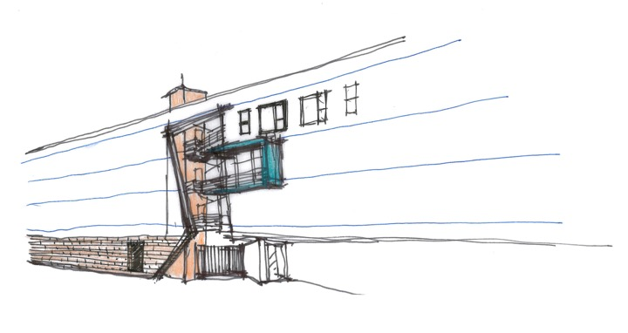
COMMON SPACE
1212 Del Paso artist lofts
Retail & neighborhood links
Ground floor retail that merges functions with building community spaces
Notes:
Linking to residents to the larger community better
Helping client with finding sympatico commercial space user that will link with residential common space and the broader neighborhood with coworker and/or combinations with other neighborhood integrating users.

Slide 14
CO LIVING
Beyond the major urban centers
Needs active urban fabric
Notes:
We are planning a small project with a couple units now
One in Sacramento with waiting list

Slide 15
LOCATION OPPORTUNITIES
Redeveloping suburbs and industrial areas
Existing site context for 701 Dos Rios Housing
Notes:
We just signed a contract wot work on this site
Pioneering a transitional industrial area
Some of our suburban redevelopment projects from before the recession have come back to life

Slide 16
FINANCING
West Gateway Place
Affordable Housing / Sustainable Communities (AHSC)
Cap & Trade will increase funding
Notes:
This project we designed is the first AHSC funded project in the State
Legislature renewal of Cap & Trade will greatly expand this financing

Slide 17
REGULATORY
VMT pricing for transportation mitigation fees in SB 743 versus congestion fee
Provides advantage for infill multifamily over single family peripheral development
Needs help to get regulations published
Contact: dmogavero@mogaveroarchitects.com
Notes:
Will benefit infill, TOD and higher density, i.e., multifamily
Some communities already doing
4 years ago wrote 1st draft of bill that became law
Need help – CIB, BIA dominated by single family, taken by surprise, now trying to stop regulations

Slide 18
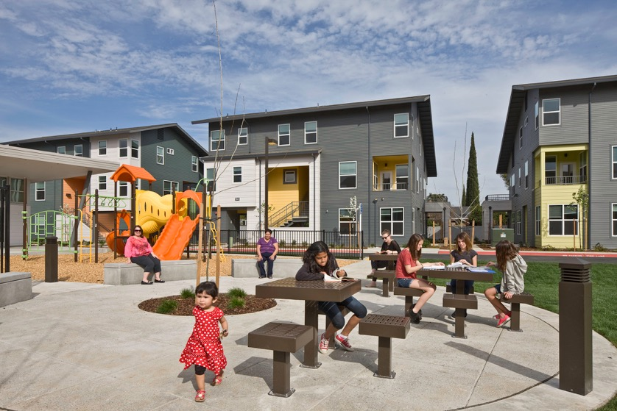
www.mogaveroarchitects.com
David Mogavero, Principal
Mogavero Architects
(916) 443-1033
dmogavero@mogaveroarchitects.com

